Slide 1
Responsive Design and media queries
By Brian MacMillan version 2017-01-29 all rights reserved.

Slide 2
Today’s Class
Responsive design and media queries

Slide 3
Responsive Design and Media Queries
Websites that are designed responsively work equally well on desktops, laptops, tablets and cell phones
Responsive design is can be implemented either with a fixed or a liquid layout, and is done so using customized css, particularly media queries (to be discussed later)
When using a liquid layout sites typically shift between one column on phones, one or two on tablets and three on a desktop depending on screen width and resolution
Example: http://www.w3schools.com/html/html_responsive.asp
Tools such as jQueryMobile and Bootstrap assist with this
When using a fixed layout designs typically are customized for each platform, often using entirely different sets of css markup.

Slide 4
Responsive Design Issues: Resolution and Layout
There are two design challenges when trying to implement a responsive design, layout and resolution
Most desktop monitors currently have a resolution of 1920 x 1080 pixels, a 16 x 9 ratio and landscape layout, though higher resolution monitors have begun to appear
Tablets typically have a 1024 x 768 pixel resolution and can display portrait or landscape
Phones can range in resolution from 320 x 480 pixels to 640 x 480 pixels to 1280 x 720 pixels to1920 x 1080 pixels. Other, less common resolution also exist.

Slide 5
Examples of Problems
Haley’s and Mikayala’s project: problems with phone view
Mashaela’s and Kayla’s project: problems with desktop view

Slide 6
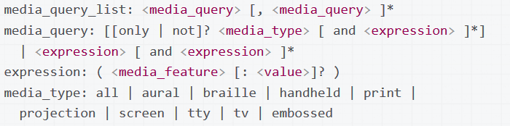
Responsive Design: SYntax
Syntax:
See also: https://developer.mozilla.org/en-US/docs/Web/CSS/Media_Queries/Using_media_queries

Slide 7
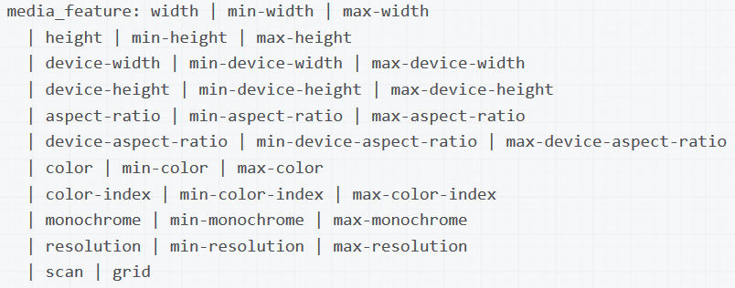
Responsive Design: Media Query Featyres
Source: https://developer.mozilla.org/en-US/docs/Web/CSS/Media_Queries/Using_media_queries

Slide 8
Response DESIGN: Use of media Queries
Can be used in the <HEAD> section of an html document to selectively load a css file
<link rel="stylesheet" media="only screen and (color)" href=“default.css" />
Can also be used within CSS. Note that the media query is a wrapper within which is placed valid CSS.
<!-- CSS media query within a stylesheet -->
<style>
@media (max-width: 600px) {
.img {max-width:256px; }
}
</style>

